Slide 1

RNS INSTITUTE OF TECHNOLOGY
DEPARTMENT OF ISE
TITLE : WORD DICTIONARY

Slide 2
Data structures can be used to organize both the storage and retrieval of information stored in both main memory and secondary memory.
Applications of data structure are as follows:
To implement a printer spooler so that jobs can be printed in the order of their arrival.
To implement the undo function in the text editor.
To store information about the directories and files in the system.
To store a set of fixed key words which are referenced very often.
INTRODUCTION

Slide 3
LINKED LIST
1) What is Linked List?
A linked list is a linear collection of data element called NODES, where the linear order is given by means of pointer.
Each node contains two fields called data element and the link field, which contains the address of the next node in the list.
This linked list data structure allows efficient way of performing insertion and deletion operations in any position.
Data field | Link
Fig-Representation of Node

Slide 4
ADVANTAGES OF LINKED LIST OVER ARRAY
Both arrays and linked lists can be used to store a linear data but ,they have some advantages and disadvantages over each other.
Following points are in favor of linked lists:
We can traverse in both directions i.e., from starting to end as well as end to starting .
It is easy to reverse the linked list.
Ease of insertion\deletion.
It allows representation of data item any where in the memory.So,it is not like array, when the memory is arranged and used sequentially.
Unlike arrays, two data elements arrangement need not be in sequence, as they are referred by their address.

Slide 5
PSEUDOCODE FOR add() FUNCTION
1. Intialize all the variables in declaration part
2. Check whether the word already exist or not
i=serach(str);
if(i)
print that “word already exist”.
3. Allocate memory dynamically to node q using malloc
q = ( struct node * ) malloc ( sizeof ( struct node ) )
4. Insert data into the node using strcpy() function
5. Enter meanings such that i<=5
6. Create a link between each node entered using add function

Slide 6
//Function to add a new word to the dictionary
void add ( char * str )
{
int i;
j = toupper ( str [ 0 ] ) - 65 ;
struct node * r, * temp = dic [ j ], * q ;
char mean [ 5 ] [ 20 ], ch = 'y' ;
i = search ( str ) ; //to check if the word is existing or not
if ( i )
{
printf ( "\nWord already exists." ) ;
getch( ) ;
return ;
}
q = ( struct node * ) malloc ( sizeof ( struct node ) ) ; //dynamic memory allocation
strcpy ( q -> data, str ) ;
q -> link = NULL ;

Slide 7
for ( i = 0 ; tolower ( ch ) == 'y' && i < 5 ; i++ )
{
fflush ( stdin ) ;
printf ( "\n\nEnter the meaning(s) : " ) ;
gets ( mean [ i ] ) ;
strcpy ( q -> m [ i ] , mean [ i ] ) ;
if ( i != 4 )
printf ( "\nAdd more meanings (y/n) " ) ;
else
printf ( "You cannot enter more than 5 meanings." ) ;
fflush ( stdin ) ;
ch = getche( ) ;
}
q -> mcount = i ;
}
if ( dic [ j ] == NULL || strcmp ( dic [ j ] -> data, str ) > 0 )
{
r = dic [ j ] ;
dic [ j ] = q ;
q -> link = r ;
return ;

Slide 8
else
{
while ( temp != NULL )
{
if ( ( strcmp ( temp -> data, str ) < 0 ) && ( ( strcmp ( temp -> link -> data, str ) > 0 ) ||
temp -> link == NULL ) )
{
q -> link = temp -> link ;
temp -> link = q ;
return ;
}
temp = temp -> link ;
}
}
}

Slide 9
//To search a word from the created dictionary
int search ( char *str )
{
struct node *n ;
char temp1 [ 20 ] ;
char temp2 [ 20 ] ;
int i ;
n = dic [ toupper ( str [ 0 ] ) - 65 ] ;
strcpy ( temp2, str ) ;
strupr ( temp2 ) ;
while ( n != NULL )
{
strcpy ( temp1, n -> data ) ;
if ( strcmp ( strupr ( temp1 ), temp2 ) == 0 )
{
printf ( "\n%s\t\t%s", n -> data, n -> m [ 0 ] ) ;
for ( i = 1 ; i < n -> mcount ; i++ )
printf ( "\n\t\t%s", n -> m [ i ] ) ;
return 1 ;
}
n = n -> link ;
}
return 0 ;
}

Slide 10
PSEUDOCODE FOR SEARCH
1.Initialize node pointer in the declaration part
2.Select a word for which to search
3.Using string comparison function compare each word
string1<string2,return -1
string1>string2,return 1
string1=string 2,return 0 and print the word.

Slide 11
PSEUDOCODE FOR DISPLAY
1.Intialise the variables
2.Using for loop print word and its meaning
printf ( "Word\t\tMeaning\n" ) ;
for ( i = 0 ; i <= 30 ; i++ )
printf ( "-" ) ;
for ( i = 0 ; i <= 25 ; i++ )

Slide 12
//To display created dictionary
void show( )
{
struct node *n ;
int i, j ;
printf ( "Word\t\tMeaning\n" ) ;
for ( i = 0 ; i <= 30 ; i++ )
printf ( "-" ) ;
for ( i = 0 ; i <= 25 ; i++ )
{
n = dic [ i ] ;
while ( n != NULL )
{
printf ( "\n%s\t\t%s", n -> data, n -> m [ 0 ] ) ;
for ( j = 1 ; j < n -> mcount ; j++ )
printf ( "\n\t\t%s", n -> m [ j ] ) ;
n = n -> link ;
}
}
}

Slide 13
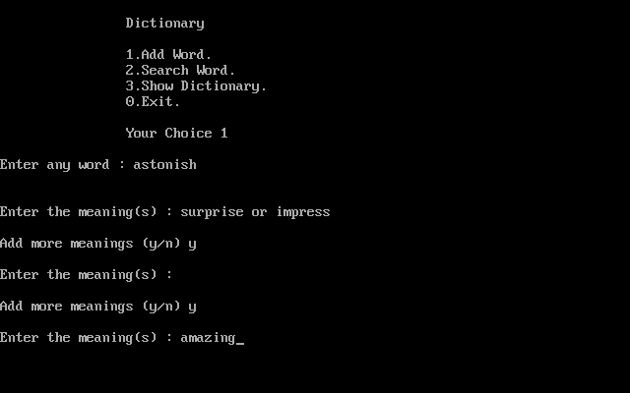
TO ADD A WORD

Slide 14
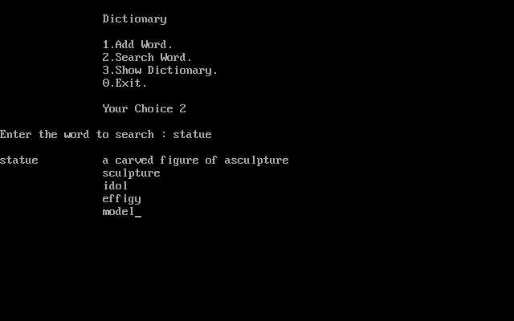
TO SEARCH A WORD

Slide 15
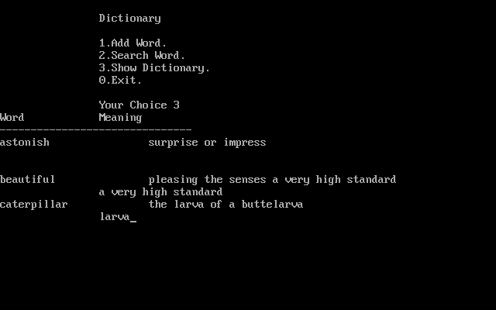
TO SHOW THE DICTIONARY

Slide 16
SPECIAL CASES

Slide 17
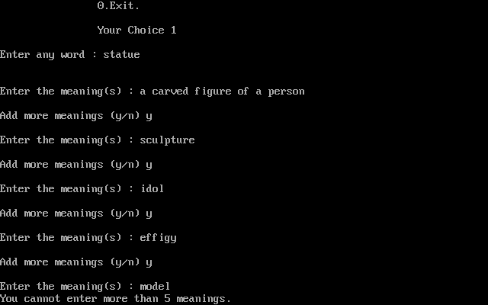
LIMITATIONS OF NO . OF MEANINGS
TO BE ADDED

Slide 18
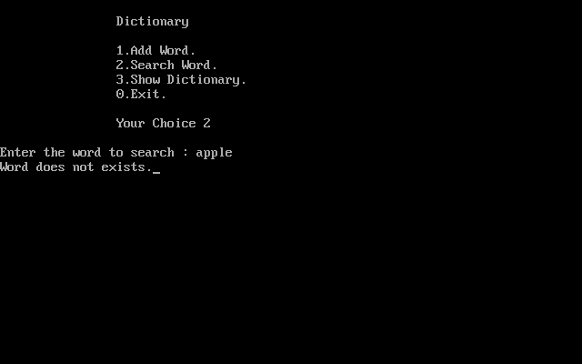
ALREADY EXISTING WORD

Slide 19
REAL TIME APPLICATIONS
It is undeniable fact that the globalization brings us to the modern effects such as the invention of mobile phones
One of the most important goals every student should have is to become an autonomous , self-sufficient learner , we can continue learning and improving for their whole life.
Due to their pervasiveness , mobile phones are considered as being potentially valuable learning tools and hence it is clear here that an application of a word dictionary in the mobile phone is requisite.

Slide 20
REFERENCES :
Github.com
Naresh technology (you tube)
Fundamentals of DSC by Horowitz,Sahni&Andreson-Freed

Slide 21
THANK YOU

